Slide 1

Medicine Control System
Final year capstone project
Group Members
Advisors Name
Miss Lelisie Daniel
Eyoel Abreham
Eyoel Zewde
Esubalew Genetu
Fantahun Ayana

Slide 2

Introduction
01
Statement of Problem
02
Objective of the project
03
Content of this presentation
Significance of the project
04
Tools used
05
Functional requirements
06
How Proposed system works
07
Future works
08

Slide 3
Introduction
As we know health is a major issue in any society. One of the important needs of people is a proper health care facility which provides all necessary services needed.
So the issue of medicine is so critical from the time it gets into the country to the time it is disposed and this is because it is very risky if it falls on the hands of unauthorized people.
We believe Medicines entering the country should be registered and distributed centrally from the government. And that patients should easily locate medicinal products prescribed for them.

Slide 4
Statement of problem
The following are among the problem that lead to propose and development of pharmacy management system software.
➢
The lack of efficient management of information
Difficulty in controlling the distribution of medicine
Difficulty in setting the selling price of medical products
The loss of connection between customers and distributers lead to the expiration of medicine and/or to the loss of life.
The lack of proper disposal of medical products lead to dangerous health issues
Hard and time consuming on preparation of daily ,weekly ,monthly and yearly reports
We have seen many medical products go almost extinct when needed by large amount of customers and we believe this is due to not knowing what is generally needed at any time in the country.

Slide 5
Objective of the project
The objective of this project is to design an efficient software that solves all the issues we stated above.
The system we are proposing enables the management of medicinal inventory or stock as well as tracks the distribution of goods around the country.
And finally our system involves actual customers (patients) in enabling them locate medicines near their surroundings.

Slide 6
Significance of the project
The system will enable the government bodies
to control what goes in and out of the country, to control the expiration date of the products.
to ensure that expired products or products with low quality that could put customers at risk will never reach customers.
to regulate the price so that low income citizens could afford healthcare.
This system will enable the medicine distributers
to get many ready customers without spending too much money on advertisements.
This system will enable the customers
can get medicine nearby with a fair price without spending precious time looking for the product.

Slide 7
Tools Used
Documentation Tools Used
Microsoft Office : to write the documentation of the system.
Visual Paradigm : to design the different models used to describe the system.
Adobe XD : to design the user interface of the proposed system.
Programming Languages selected for implementation:
Front End – React JS and Material UI
Backend – Node.JS.
DataBase – Mongo DB

Slide 8
FUNCTIONAL REQUIREMENTS
system should allow users to login
system should allow pharmacy owners to send signup request to the administrative staff
system should display available signup request on the admins dashboard
system should allow admin staffs to register a pharmacy
system should allow users to update their account
system should allow pharmacy owners to send deletion request to the administrative staff
system should display available deletion request on the admins dashboard
system should display list of available stocks
system should allow users to purchase stock

Slide 9
Continued: FUNCTIONAL REQUIREMENTS
system should allow the pharmacy owners to request stocks
system should allow pharmacy owners to cancel their orders
system should allow pharmacy owners pharmacy owners to report defect
system should display defect report on the admin dashboard
system should allow admin staff to replace items with a certain defect
system should allow users to attach payment
system should allow admins to approve attached payment
system should allow customers to search for medicine
system should allow users to logout
system should allow users to sell stock
system should allow pharmacy owners to change the password given to them by the admin staffs

Slide 10
How the system works
our system has three actors , namely:
Administrative staff : authorized person from the ministry of food and health that establishes control of the system being proposed.
Pharmacy Owner : People that own or manage a pharmacy that is part of the system.
Customer : Any ordinary individual that wants information about any medical product or service on this platform.

Slide 11
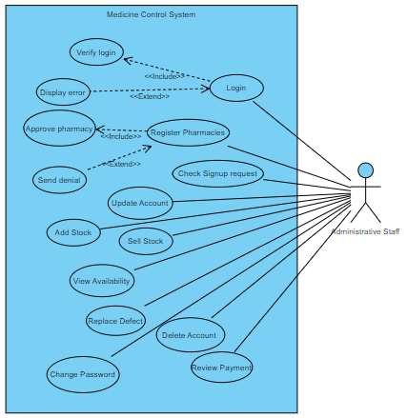
Use cases for administrative staff

Slide 12
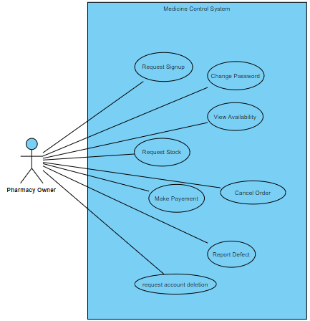
Use Cases for Pharmacy Owners

Slide 13
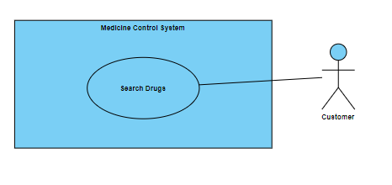
Use Cases for Customers

Slide 14
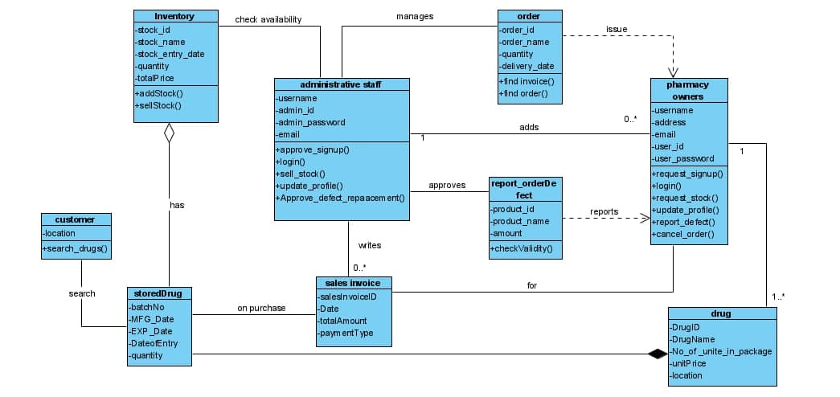
Class diagram of our system

Slide 15
Thank You !!

